Slide 1


Google Data Analytics Capstone Project: Cyclistic 2022
| Tableau | R | SQL
Created by:
Michael Anaga
Last Updated:
5/30/2023 10:52:15 AM UTC

Slide 2
Google Data Analytics: Capstone Project Case Study: How Does a Bike-Share Navigate Speedy Success?
Business Task (The reason for the analysis)
How do annual members and casual riders use Cyclistic bikes differently?
Why would casual riders buy Cyclistic annual memberships?
How can Cyclistic use digital media to influence casual riders to become members?

Slide 3
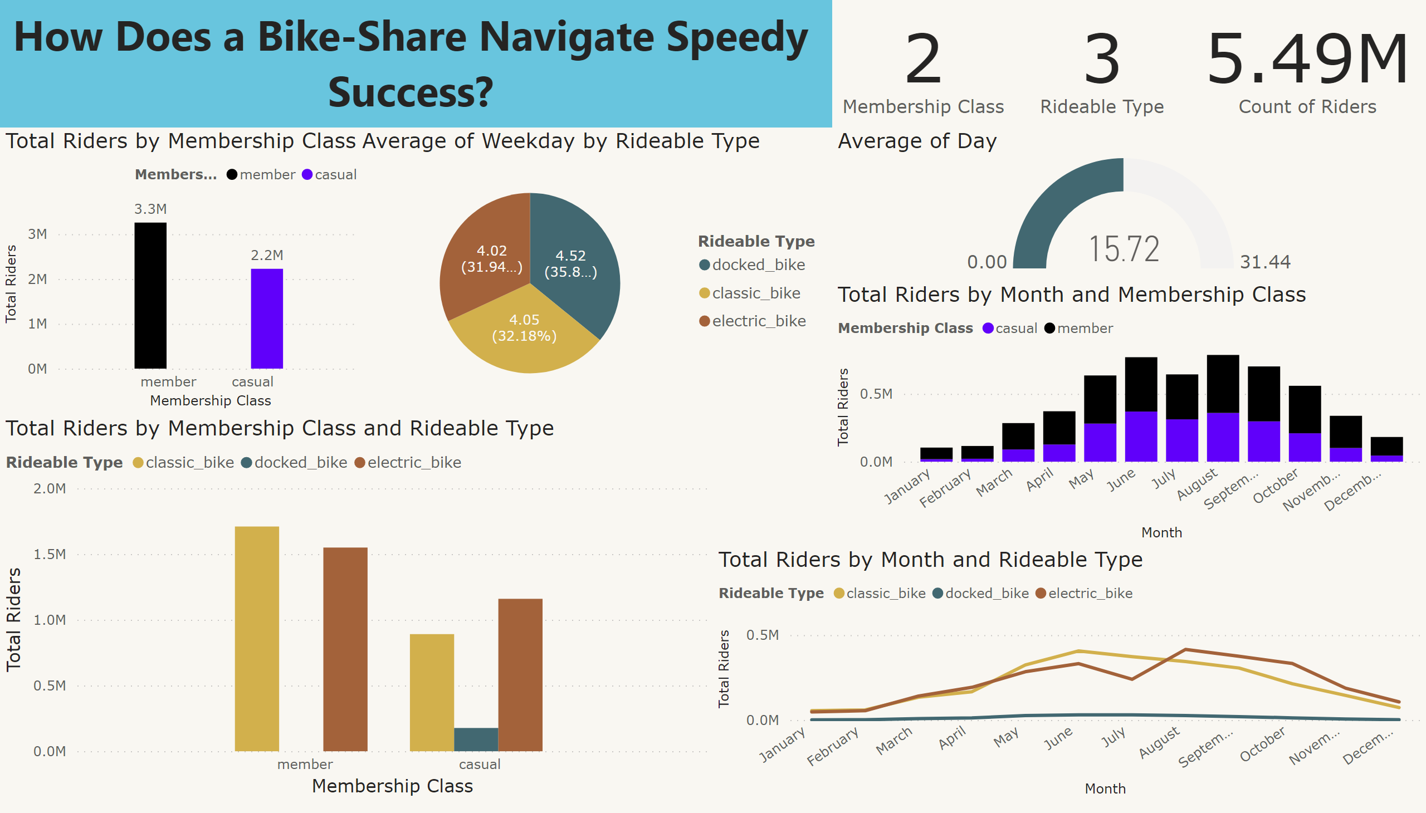
Page 1

Slide 4
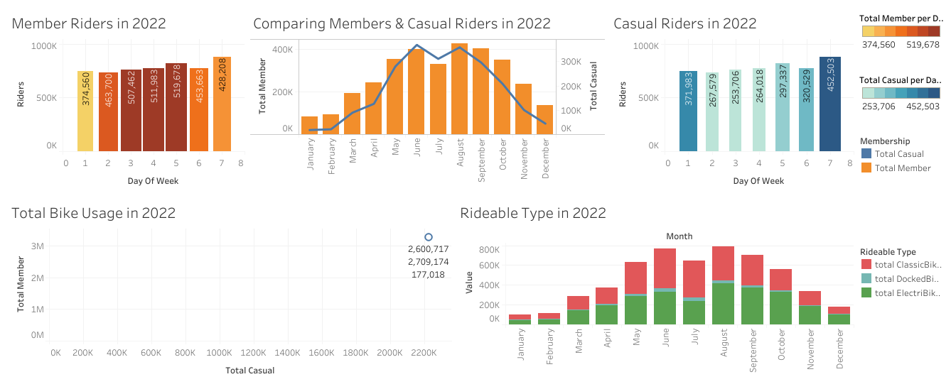
How membership class use Cyclistic bikes differently & Why casual riders buy annual memberships

Slide 5
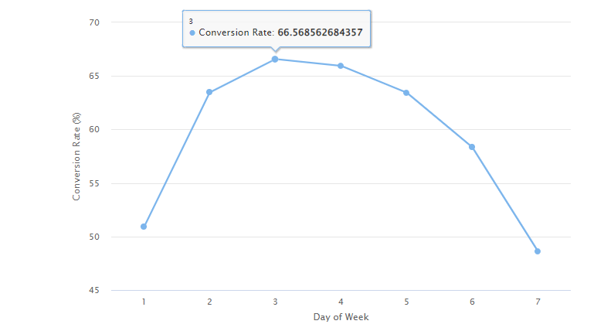
Digital media to influence casual riders
The analysis indicates that Wednesday has the highest conversion rate of Casual riders, with approximately 66.5% conversion rate.
Conversely, Sunday has the lowest conversion rate of approximately 48.6%.

Slide 6
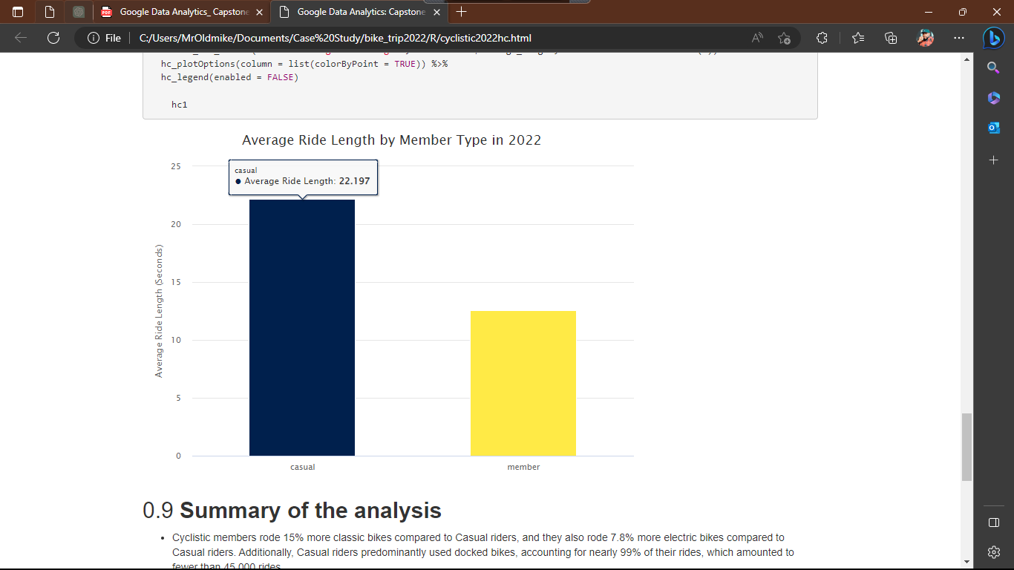
Would casual riders buy annual memberships
The average ride duration for Casual riders is approximately 22 minutes, while for Cyclistic members, it is approximately 12 minutes.
This indicates that, on average, Casual riders spend approximately 29.4% more time riding a bike which leans towards the need of purchasing annual membership.

Slide 7
Summary of the analysis
Cyclistic members rode 15% more classic bikes and 7.8% more electric bikes compared to Casual riders. Casual riders mostly used docked bikes, accounting for nearly 99% of their rides, which amounted to fewer than 45,000 rides.
The average ride duration for Casual riders was 22 minutes, indicating they spend approximately 29.4% more time riding compared to Cyclistic members, who averaged 12 minutes per ride.
Casual riders use Cyclistic bikes more on Sundays, with approximately 2.8% more rides compared to Cyclistic members. Cyclistic members use the service more on the rest of the days.
Wednesday has the highest conversion rate of Casual riders becoming Cyclistic members, at approximately 66.5%, while Sunday has the lowest conversion rate of 48.6%.
In 2022, Cyclistic members accounted for 59.4% of total riders, while Casual riders made up 40.6%, resulting in an 18.8% difference between the two groups.
June and July show a marginal difference of approximately 4% and 3% respectively in terms of ridership between Cyclistic members and Casual riders.
August had the highest number of rides for Cyclistic members, while January had the lowest. For Casual riders, June had the highest number of rides, while January had the lowest.

Slide 8
Conclusion / Proposal
In 2022, June, July, and August saw the highest number of casual riders. To convert these casual riders into Cyclistic members, digital marketing, advertising, and additional incentives should be focused on these months. Cyclistic annual members accounted for 59.4% of total riders, while casual riders made up 40.6%. This significant difference presents an opportunity to target and convert casual riders into Cyclistic members.
To facilitate this conversion, frequent promotional campaigns should target the working class, discounted fees should be offered to riders with disabilities, and refined incentives should be designed for sports or leisure riders. These strategies aim to attract and incentivize casual riders to become dedicated Cyclistic members.
The analysis reveals that Cyclistic members primarily use the service for leisure purposes with an average ride duration of 12 minutes, while casual riders use it for commuting and sports with an average ride duration of 22 minutes. This suggests that providing a sport-type bike option could help convert casual riders into Cyclistic members. Offering a bike model specifically designed for sports and leisure activities could attract these riders and enhance the appeal and suitability of the bike-sharing service for them

